Slide 1
The Florida State University
Building Trust: The Critical Success Factor (CSF) of a BI Initiative
Session #27717
March 1, 2010

Slide 2
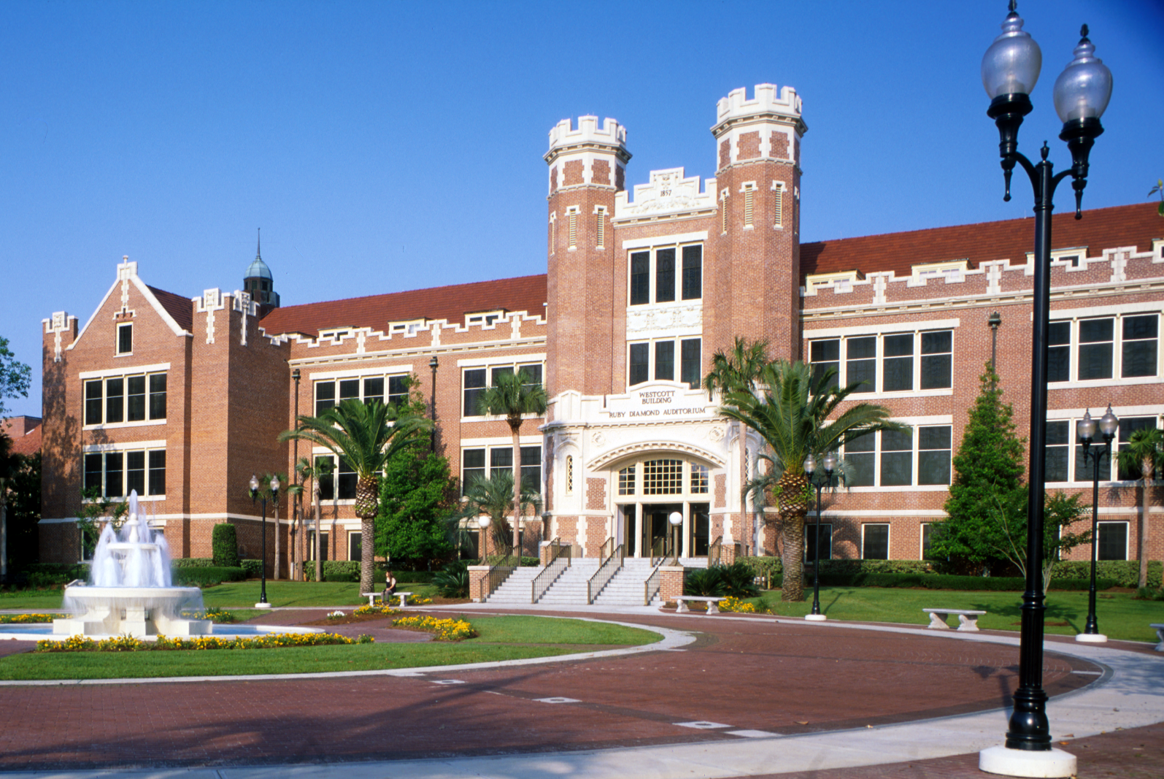
The Florida State University
Current Enrollment 40,255

Slide 3
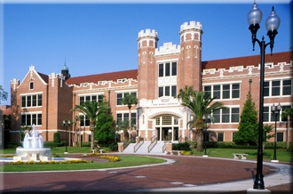
The Florida State University
…is a premier, comprehensive, graduate research university, with both law and medical schools.
Annual Operating Budget: $1.1B
Over 40,000 students
Over 13,000 employees
Over 13,000 biweekly paychecks
Over $18 million in biweekly payroll

Slide 4
Overview
Introduction to FSU’s ERP Initiative
Overview of FSU’s OBIEE Implementation
Define Trust and discuss why it matters in a BI Initiative
What are the components of Trust in BI and FSU’s approach?
How trust affects the usability and pervasiveness of BI
  Are we there yet? What’s next…
Questions & Comments

Slide 5
FSU and Oracle PeopleSoft
Implemented Financials 8.4, Portal 8.8, and EPM 8.8 in June 2004
Implemented HR/Payroll 8.8 in Dec 2004
Upgraded HR & EPM Suites to 8.9 in April 2006
Upgraded FI Suite to 8.9 in Nov 2006
Upgraded EPM & Portal Suites to 9.0 in Nov 2007
Upgraded HR Suite to 9.0 in Oct 2008
Upgraded FI Suite to 9.0 in April 2009
Deployed EPM 9.0 & OBIEE 10.1.3.3 (Windows) in Mar 2008
Upgrade OBIEE 10.1.3.4 (Linux) in April 2009

Slide 6
FSU’s BI Profile
Deployed new BI Solution 2 years ago
Solution meets the reporting needs of our the major Administrative organizations on Campus
Consists of 25 Dashboards and 27 Subject Areas
Over 1200 distinct users & 2.5 Million Requests
Dashboard Consumption & Self Service Reporting
Currently in Phase III of our Deployment (*Standardizing BI on OBIEE)
2009 Oracle Innovation Award Recipient

Slide 7
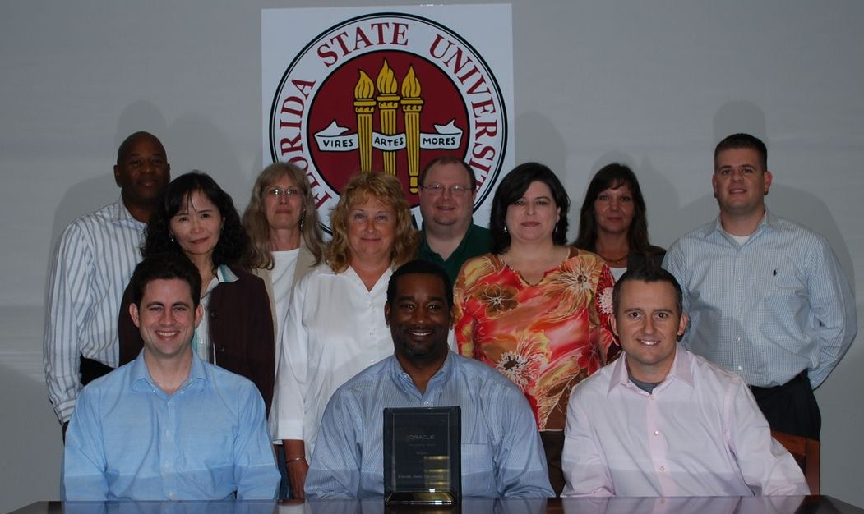
2009 Oracle Innovation Award
Notes:
Unsung heros and sheros.
BI requires cross-functional team work…Importance of functional involvement in a BI Initiative.
“Technically led but Business driven”

Slide 8
10 Important Aspects of BI Success
IT and business partnership (3.37)
Executive support (3.34)
Data quality – clean data (3.30)
Alignment with business goals (3.27)
Reliability of BI System (3.18)
Quality and expertise of internal BI staff (3.11)
Availability of relevant subject areas (3.05)
Appropriate and effective BI tools (3.02)
BI program has been well-managed (2.96)
Fast Query response time (2.84)
List Adopted from ©2008 Successful Business Intelligence by Cindi Howson (BI Scorecard)

Slide 9
Trust Defined
Webster
1. reliance on the integrity, strength, ability, surety, etc., of a person
or thing; confidence.
2. confident expectation of something; hope.
3. a person on whom or thing on which one relies: (i.e. God is my trust)

Slide 10
Trust Defined
Webster
1. reliance on the integrity, strength, ability, surety, etc., of a person
or thing; confidence.
2. confident expectation of something; hope.
3. a person on whom or thing on which one relies: (i.e. God is my trust)
As it relates to a BI Initiative
Knowledge and assurance that accurate information will be available when it is needed, where it is needed and how it is needed to support/improve an organizations ability to make business decisions and be more productive.

Slide 11
Trust Defined
Webster
1. reliance on the integrity, strength, ability, surety, etc., of a person
or thing; confidence.
2. confident expectation of something; hope.
3. a person on whom or thing on which one relies: (i.e. God is my trust)
As it relates to a BI Initiative
Knowledge and assurance that accurate information will be available when it is needed, where it is needed and how it is needed to support/improve an organizations ability to make business decisions and be more productive.
What happens to trust when this is definition is not met? Can trust be build even when….Data is late! BI server crashes!! Data is crap!!!

Slide 12
Trust Defined
Webster
1. reliance on the integrity, strength, ability, surety, etc., of a person
or thing; confidence.
2. confident expectation of something; hope.
3. a person on whom or thing on which one relies: (i.e. God is my trust)
As it relates to a BI Initiative
Knowledge and assurance that accurate information will be available when it is needed, where it is needed and how it is needed to support/improve an organizations ability to make business decisions and be more productive.
What happens to trust when this is definition is not met? Can trust be build even when….Data is late! BI server crashes!! Data is crap!!!
Does trust come only by building a suite robust data marts and effective dashboards? NO

Slide 13
Trust Defined
Webster
1. reliance on the integrity, strength, ability, surety, etc., of a person
or thing; confidence.
2. confident expectation of something; hope.
3. a person on whom or thing on which one relies: (i.e. God is my trust)
As it relates to a BI Initiative
Knowledge and assurance that accurate information will be available when it is needed, where it is needed and how it is needed to support/improve an organizations ability to make business decisions and be more productive.
What happens to trust when this is definition is not met? Can trust be build even when….Data is late! BI server crashes!! Data is crap!!!
Does trust come only by building a suite robust data marts and effective dashboards? NO
It’s much more than that….Trust in BI is built overtime by focusing on multiple components

Slide 14
Prime components of Trust in BI
What if the data is right but….
BI Trust
Vision
Leadership
Process
Product

Slide 15
Prime components of Trust in BI
Organizational
BI Trust
Vision
Leadership
Process
Product
Technical

Slide 16
Vision Element
Defined, championed, and communicated by executive leadership
Clear, understandable and tangible
Aligned with the needs of the University’s needs.
Organization structured to realize the vision

Slide 17
Vision Element
Defined, championed, and communicated by executive leadership
Clear, understandable and tangible
Aligned with the needs of the University’s needs.
Organization structured to realize the vision
FSU BI Vision
OBI Reporting project was to change the paradigm of reporting to one of enabling power users, analysts, and casual users to analyze structured summary and detailed information in an easy-to-access format.

Slide 18

Leadership Element
Strong executive support from key stakeholders of the organization
Strong partnership between Business and IT organizations
Team composed of competent personnel
Team has core competency in in BI/DW core areas.
  BI/DW Architecture
  Dashboard Development
  Data Integration
  Data Modeling
  Data Quality
  Packaged Applications

Slide 19

Process Element
Governance Structure that maintain Business Alignment
  BI Project Portfolio Management
Effective processes defined for BI/DW
Dev. and Operations
  BI Requirements to Deployment
  Process
  Issue reporting and resolution
  Environment Refresh
  Change Control Process
  Etc.

Slide 20
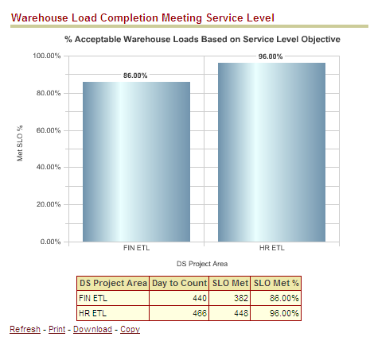
Product Element
Meeting the Business Requirements
Responsiveness of the BI Application
  Tuning & Availability
Timeliness of the information
  Meeting SLO
Usability of the BI Solution
    Data Reconciliation
Transparency of operations
  Operations dashboards
  Informational Messages

Slide 21
Data Reconciliation

Slide 22
Data Reconciliation
Know the system(s) that you are reconciling against
Determine the rules of reconciliation
Define metrics and determine what is acceptable
Place the correct priority on reconciliation resolution and incorporate it into standard operating procedures
Be transparent as necessary but be careful of information overload.

Slide 23

Data Reconciliation Challenges
Data entry in the source systems during reconciliation process execution.
SQL delete statements executed manually or systematically (via a batch process).
Deletion of data from OLTP using change history/delete row capability.
Inconsistent reconciliation rules due to maturing environment

Slide 24

Data Reconciliation Process Flow
OLTP -> OWS
Row Counts
Monetary Amounts
OWS -> MDW
Facts vs. Trans Tables
MDW -> MDW
Summary vs Detail Tables
Monetary Amounts
Dimension vs. Config Tables
DataStage
OBI

Slide 25
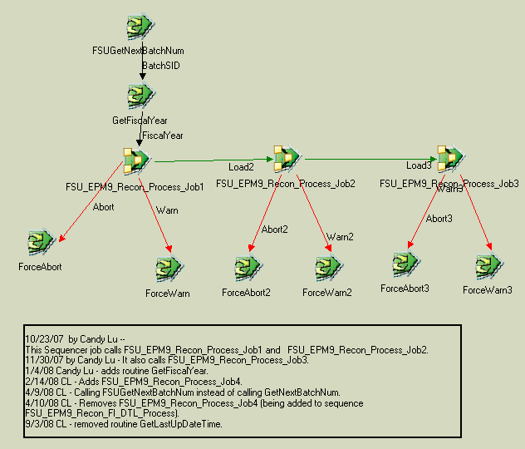
Data Reconciliation ETL Process

Slide 26
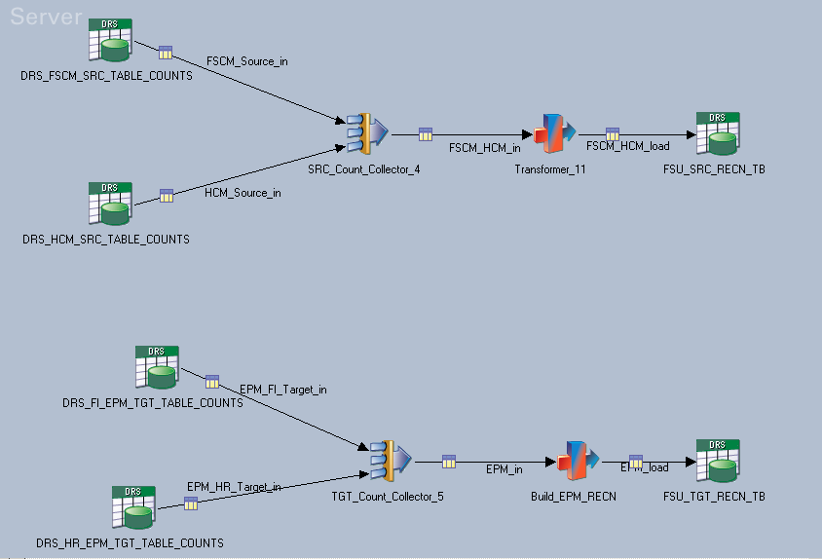
Data Reconciliation ETL Process
Step 1: Load row counts from OLTPs and EPM OWS and load into
Recon table

Slide 27
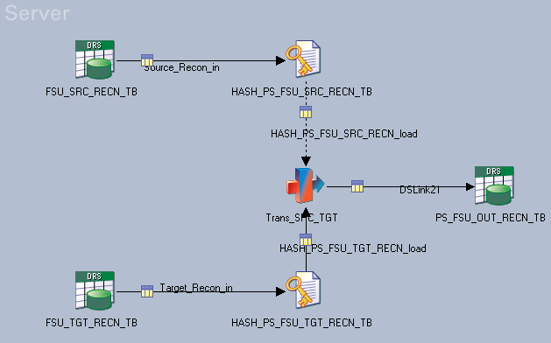
Data Reconciliation ETL Process
Step 2: Compare row counts and set interim Recon flag value
Notes:
Our reconciliation process attempts to verify that the data in the EPM Warehouse represents the data in the transactional systems. This is done by:
Comparing row counts between all the OLTP to OWS tables.
Comparing data aggregations between key transactional tables in the OWS.
Comparing OWS to MDW data aggregations at the account type level for Financials and University Level for HR.

Slide 28
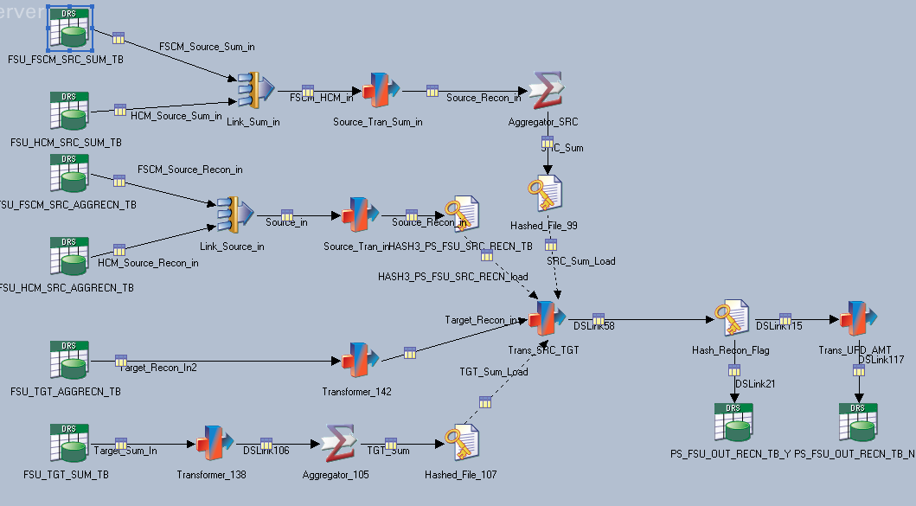
Data Reconciliation ETL Process
Step 3: Capture control totals (amounts) by table and by applicable
major chartfields. Compare values and set interim Recon flag value
Notes:
'PS_LEDGER', SUM(POSTED_TOTAL_AMT) for current fiscal year
'PS_LEDGER_KK’
'PS_KK_ACTIVITY_LOG’
'PS_JRNL_LN’
'PS_DIST_LN’
'PS_VCHR_ACCTG_LINE’
'PS_EX_ACCTG_LINE’
'PS_BI_ACCT_ENTRY’
'PS_PAY_MISC_DST’
PS_JOB
Same tables sum amount and aggregate to FISCAL_YEAR,ACCOUNTING_PERIOD,DEPTID,FUND_CODE,ACCOUNT
Except Job aggregate to Dept

Slide 29
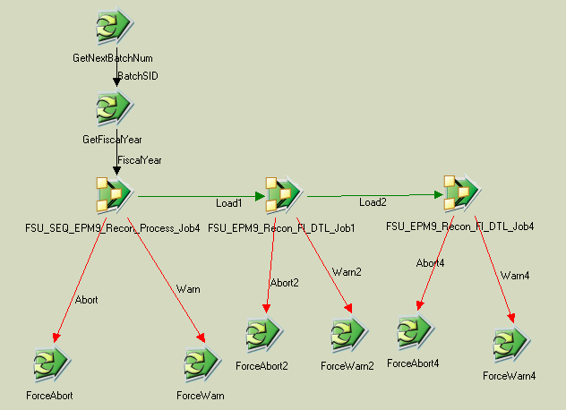
Data Reconciliation ETL Process

Slide 30
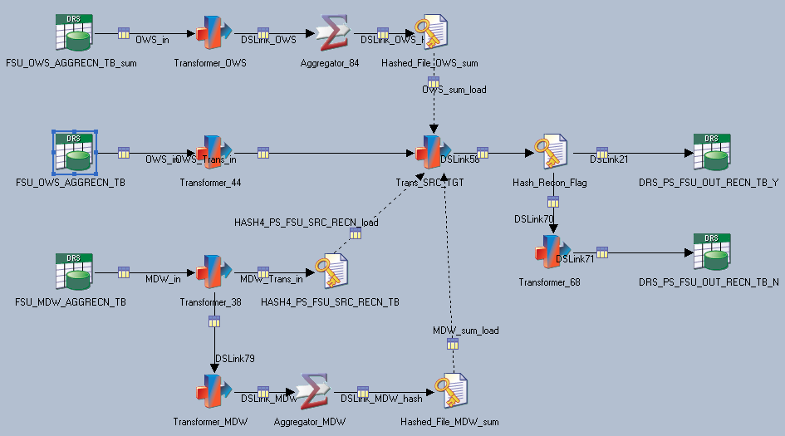
Data Reconciliation ETL Process
Step 4: Capture OWS control totals (summary amounts) by account type compare with corresponding MDW control total. Set interim Recon flag value

Slide 31
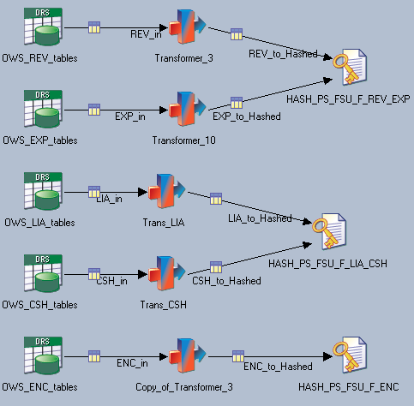
Data Reconciliation ETL Process
Step 5: Capture OWS control totals (detail amounts) by account type and
store the results.

Slide 32
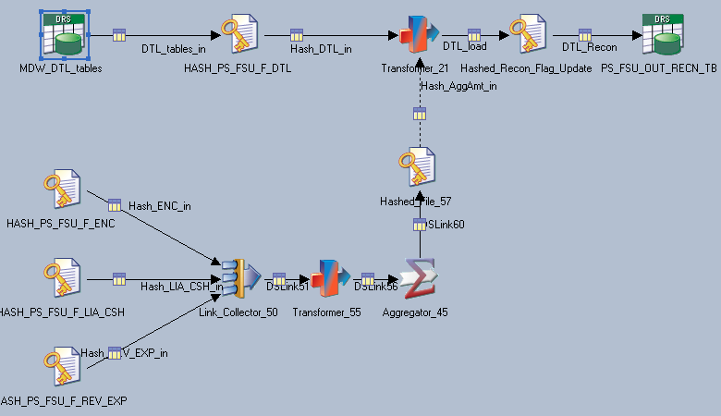
Data Reconciliation ETL Process
Step 6: Capture MDW control totals (detail amounts) by account type and
compare them to the OWS amounts. Set the Recon flag

Slide 33
Data Reconciliation OBI Process
OLTP -> OWS
Row Counts
Monetary Amounts
OWS -> MDW
Facts vs. Trans Tables
MDW -> MDW
Summary vs Detail Tables
Monetary Amounts
Dimension vs. Config Tables
DataStage
OBI

Slide 34
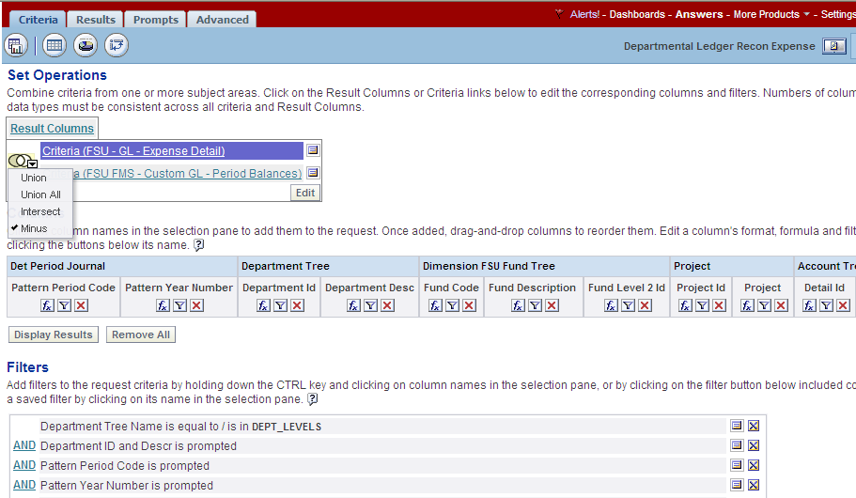
Data Reconciliation OBI Process
Step 7: Ibot executes a series of reports and distributes them to subscribers.
Reports compare MDW tables Summary to Detail.

Slide 35
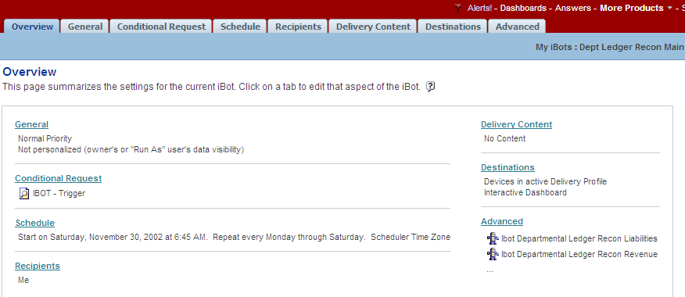
Data Reconciliation OBI Process
Notes:
Our reconciliation process attempts to verify that the data in the EPM Warehouse represents the data in the transactional systems. This is done by:
Comparing row counts between all the OLTP to OWS tables.
Comparing data aggregations between key transactional tables in the OWS.
Comparing OWS to MDW data aggregations at the account type level for Financials and University Level for HR.

Slide 36
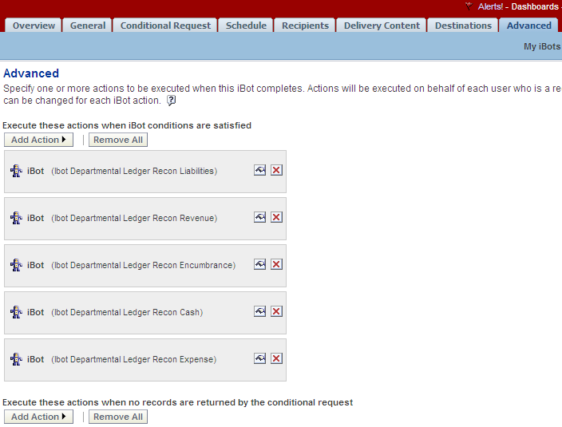
Data Reconciliation OBI Process

Slide 37
Data Reconciliation Process Flow
OLTP -> OWS
Row Counts
Monetary Amounts
OWS -> MDW
Facts vs. Trans Tables
MDW -> MDW
Summary vs Detail Tables
Monetary Amounts
Dimension vs. Config Tables
DataStage
OBI

Slide 38
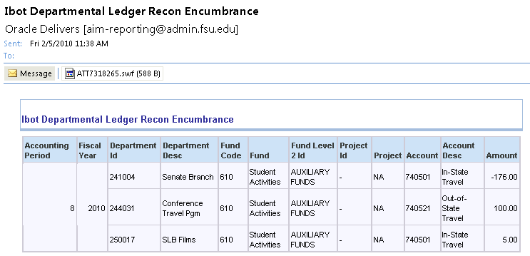
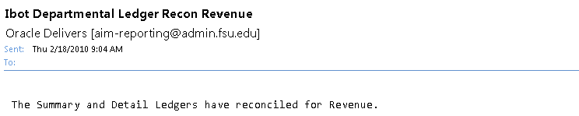
Data Reconciliation Process Flow
50 issues yesterday and only 3 today.YEEHAW!
Crap 3 recon issues to resolve….

Slide 39
Dashboard Messages

Slide 40

Dashboard Messages
How do I know if my data is ready for consumption?
Are those ETL processes complete?
When was the data for this dashboard refreshed? What about the other dashboard?
Let the system communicate to the users…

Slide 41
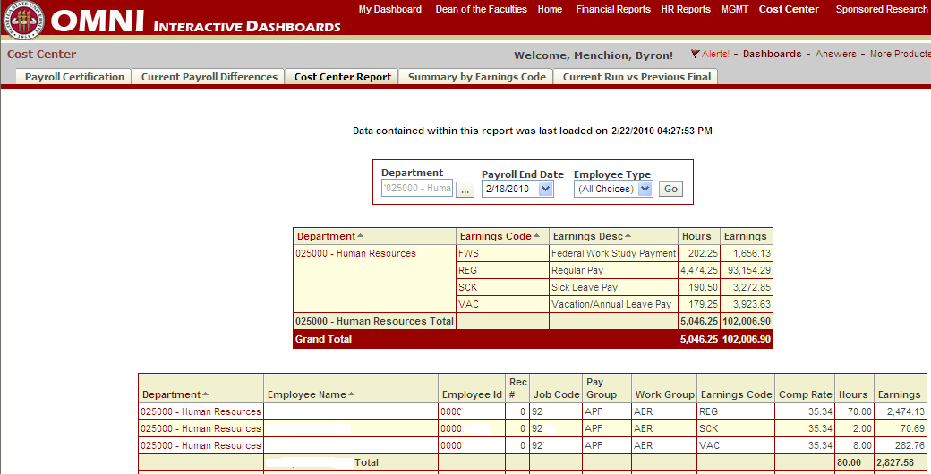
Dashboard Messages
Conditional message to users based on the status of
the data loading processes. Specific to Facts/Dims

Slide 42
Dashboard Messages (Using DS_JOBS)
Data Stage
OBIEE
Dashboard Message
Guided Navigation
Repository
Oracle DW
Data contained within this report was last loaded on Max DS_JOBS.Date
DS_JOBS
DS_JOBS
Data is currently being populated.
DS Services

Slide 43
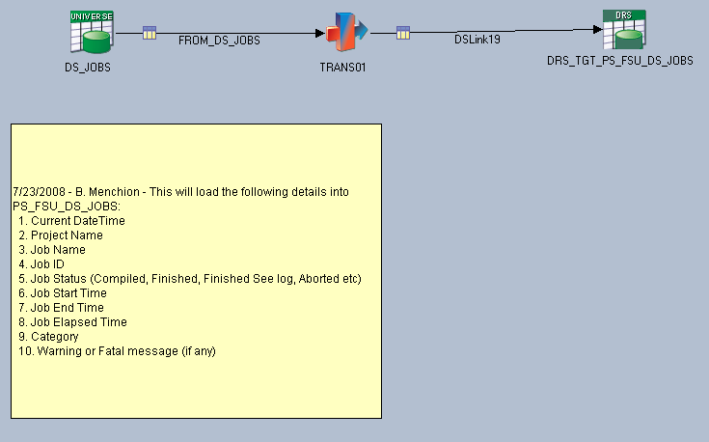
Dashboard Messages (Using DS_JOBS)
Process simply extracts data from DS Jobs, enriches
the data via routine and load it into Oracle.

Slide 44
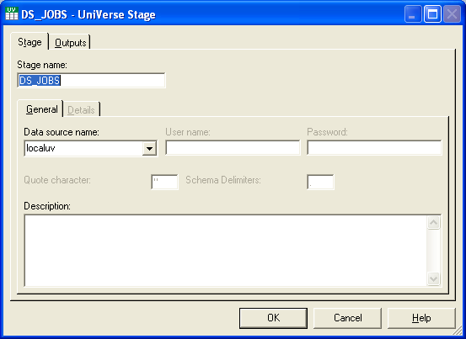
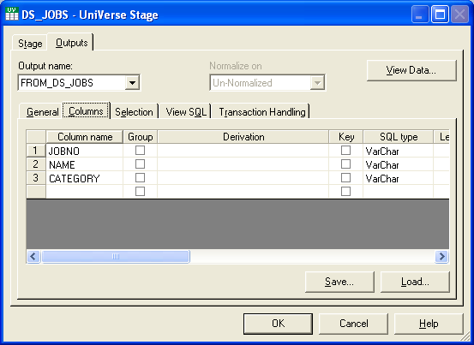
Dashboard Messages (Using DS_JOBS)

Slide 45
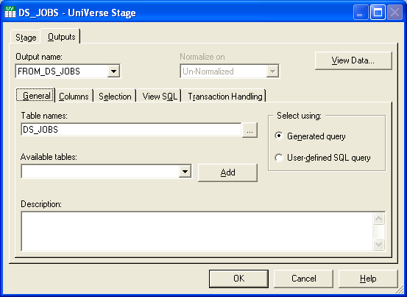
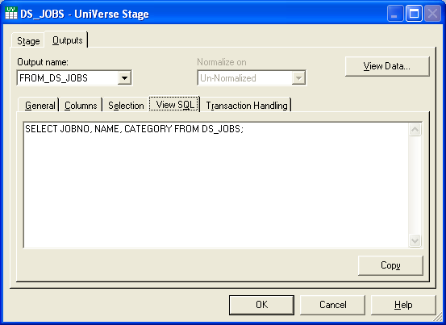
Dashboard Messages (Using DS_JOBS)

Slide 46
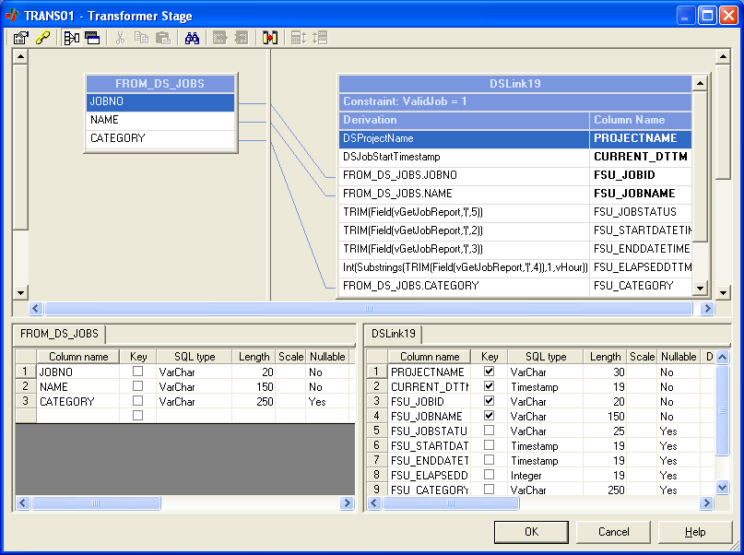
Dashboard Messages (Using DS_JOBS)

Slide 47
Operational Dashboards

Slide 48
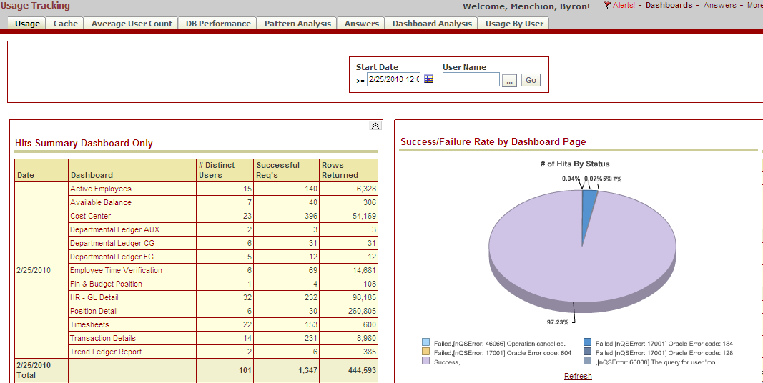
Operational Dashboards
Track usage of the application and measure dashboard
and database performance.

Slide 49
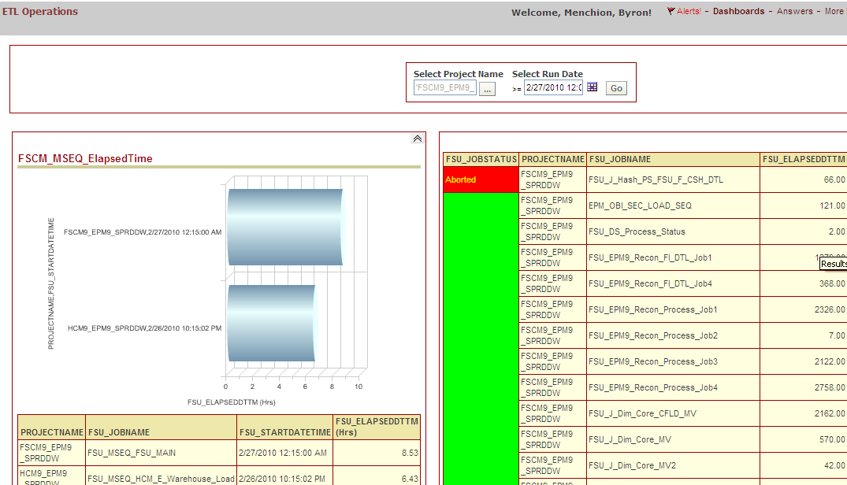
Operational Dashboards
Measure ETL performance and receive alerts and other
exception reports using DS_JOBS data.

Slide 50
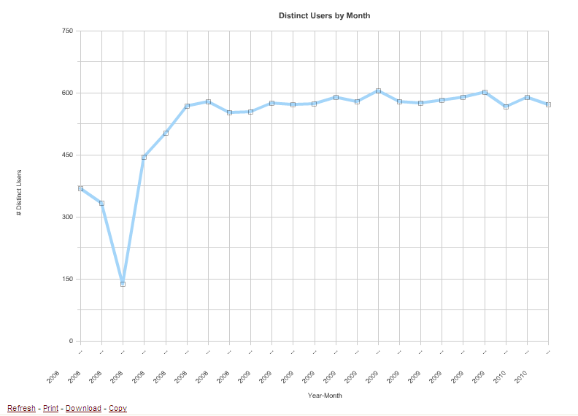
User Adoption
Refining Operations
Steady State
Go Live
Reintroduce Reports
Stability/Data Issues
Reports Removed

Slide 51
Affects of BI Trust
BI Trust
Strong Adoption
Business Outcomes
Diagram Adopted from ©2008 TDWI Article “The BI Tipping Point” Wayne W. Eckerson

Slide 52
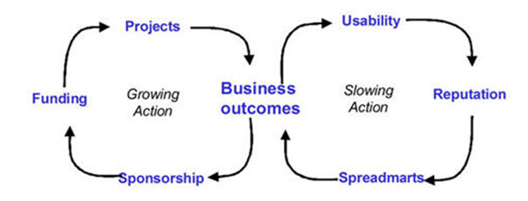
Affects of BI Trust
BI Trust
Strong Adoption
Business Outcomes
Diagram Adopted from ©2008 TDWI Article “The BI Tipping Point” Wayne W. Eckerson

Slide 53
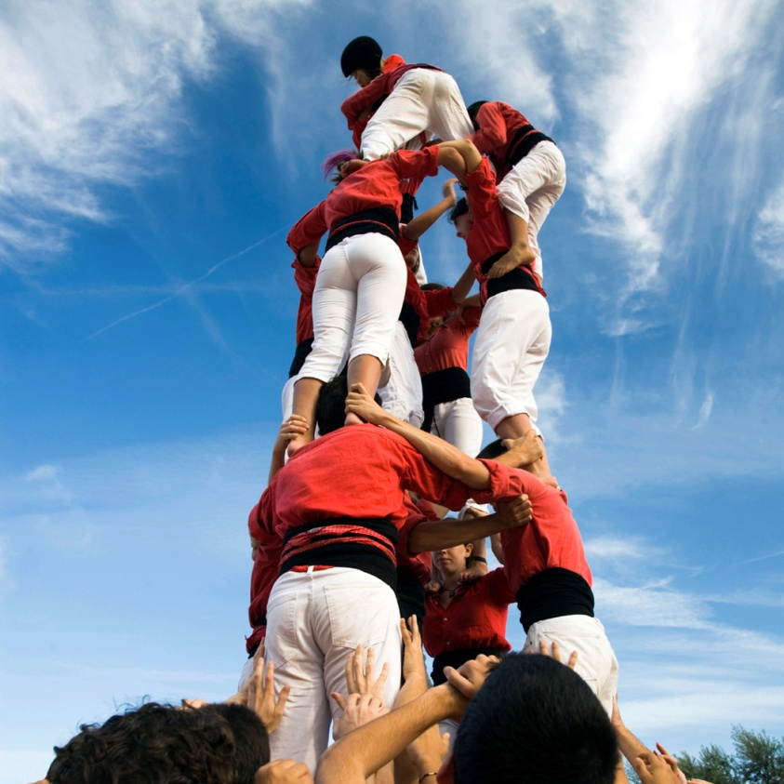
  Are we there yet? What’s next…
NO..Journey not Destination
But the conversation has changed
  We love it and want more
  OLTP changes
  Process changes
On the horizon:
Oracle MDM/IdM
Oracle Streams technology
Expanding user base to Student centric organizations
Improved BI business processes

Slide 54
Words of Wisdom
Focus on all 4 aspects of the BI Trust
Create partnerships with business or functional team members and maintain throughout the BI Lifecycle.
Establish trust in the warehouse early and NEVER underestimate the importance of DI/DQ.
Focus on data reconciliation early and consistently.
Measure & Monitor operational metrics and make improvements as needed.
Be transparent with BI/DW Operations.
Notes:
Understand the business and how BI impacts their job.

Slide 55
Contact
Byron Menchion
Associate Director
Enterprise Resource Planning (ERP)
Florida State University
Bmenchion@admin.fsu.edu
Thanks for attending Session #27717. I value your feedback. Please complete the session survey.

Slide 56
This presentation and all Alliance 2010 presentations are available for download from the Conference Site
Presentations from previous meetings are also available

